Slide 1

Center for Creative Leadership Leadership Development Analysis
Team: Decametrix
Members: Patricia Hurlocker, Marcus Manahan, Muriel Marable, Jasmine Kwok

Slide 2
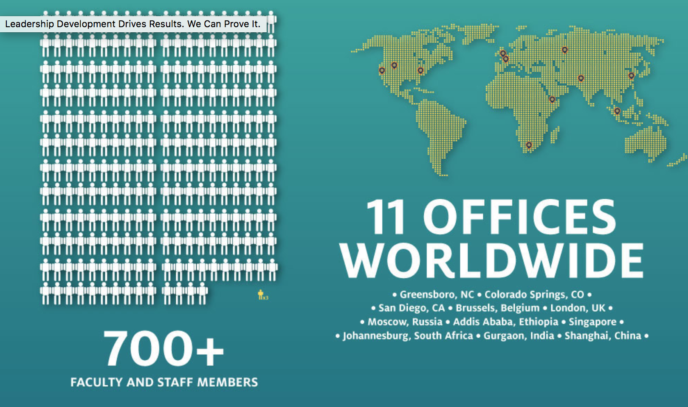

Slide 3
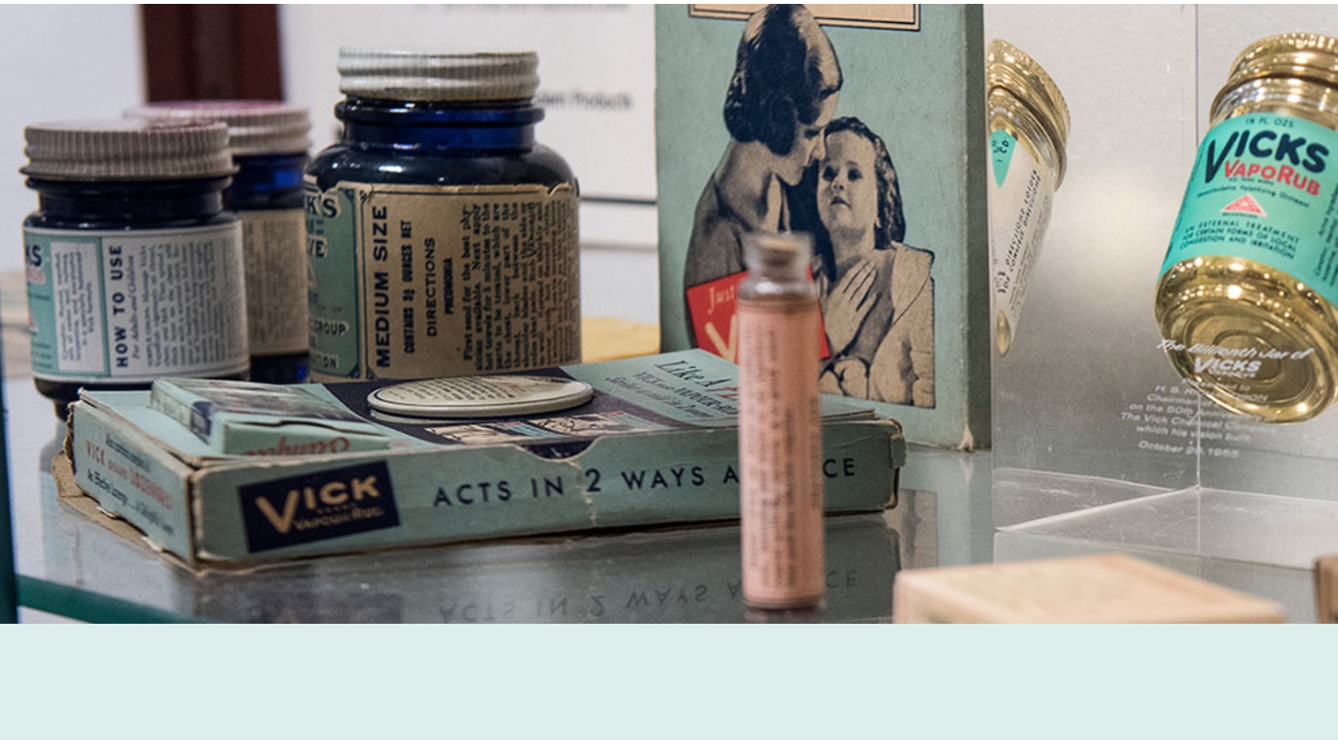
Quick origin story

Slide 4
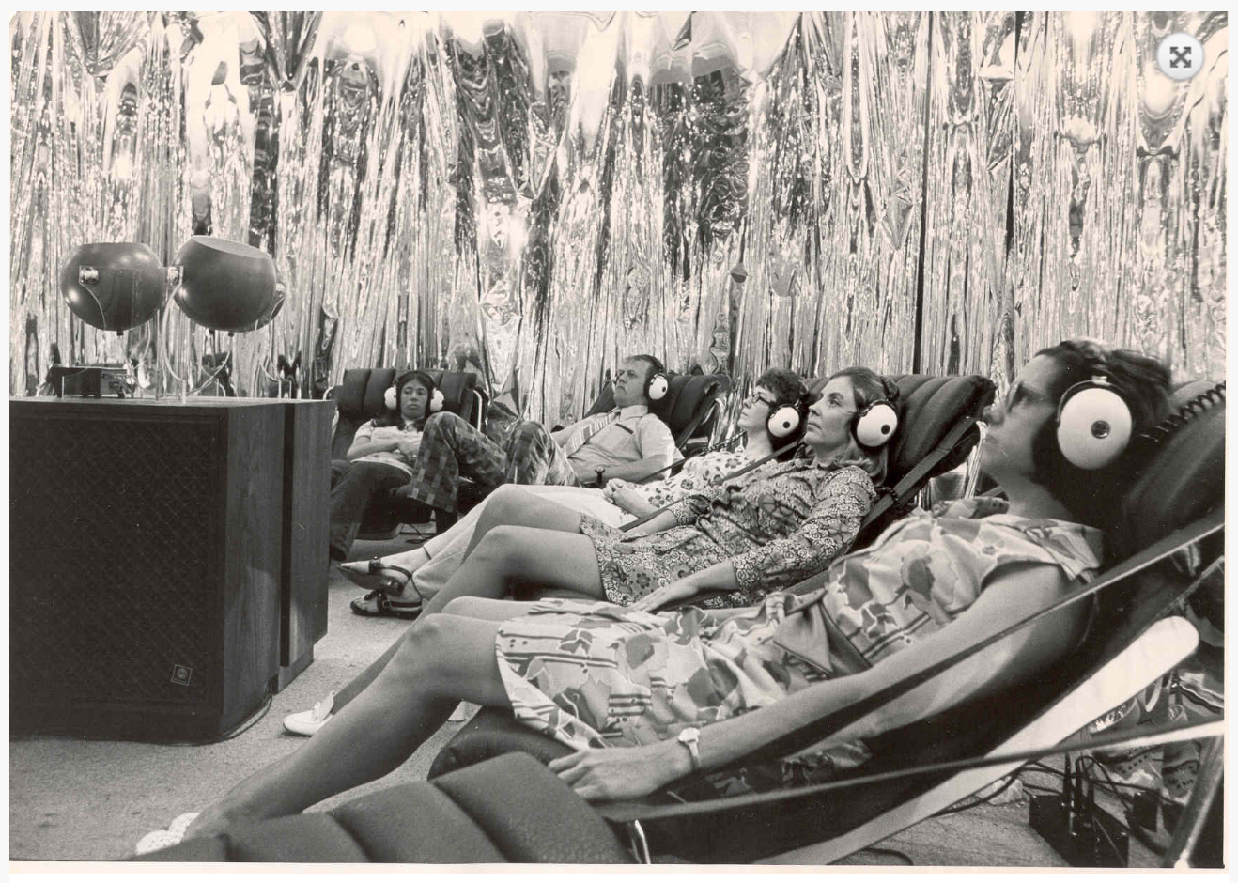
Center for Creative Leadership - 1972
First programs were 16 weeks long!

Slide 5
3 Flagship programs
MLP – Maximizing Your Leadership Potential (3 Days)
LDP – Leadership Development Program(5 Days)
LOI – Leading for Organizational Impact (5 Days)

Slide 6
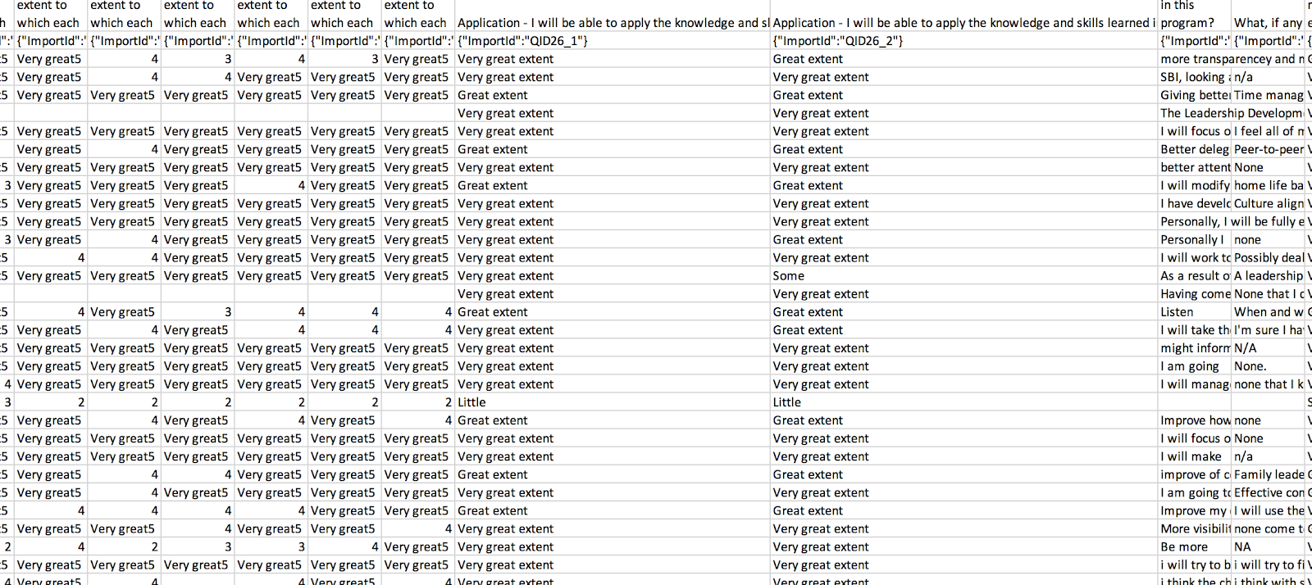
Nature of Data Collected
Overall satisfaction
Achievement of objectives
Application of skills learned
Training staff
Supporting services (hotel, facility)

Slide 7
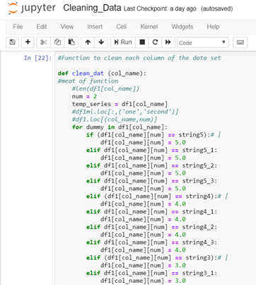
Cleaning the Data
Investigating the dataset:
Inconsistent naming conventions
Survey responses varied by column
Function to clean the data:
Clean_dat(“column name”)
Multiple cases
35
25
15

Slide 8
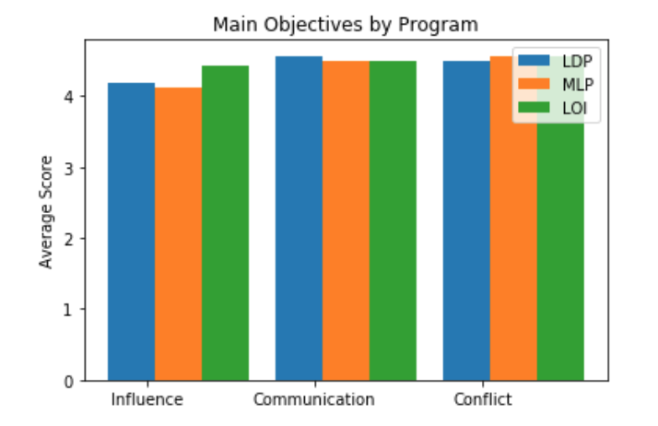
Achievement of Objectives
Different target audience and focus per program, but overall minimal difference between mean scores on achievability and applicability
Common Threads
Influence
Communication
Dealing with conflict

Slide 9
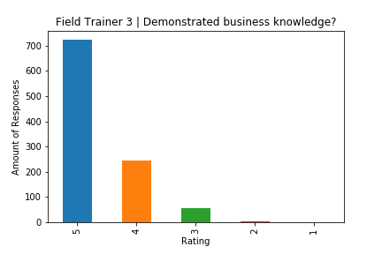
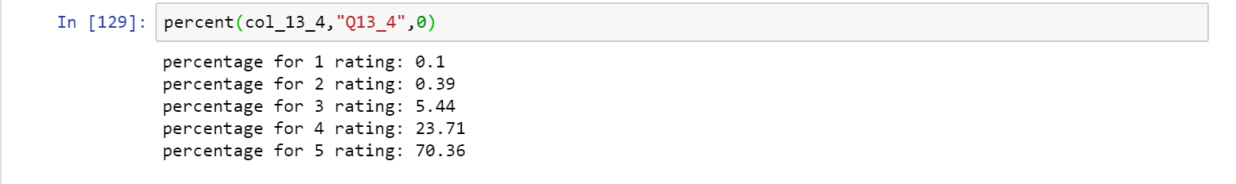
Faculty Ratings
Findings
Multiple bar graphs of the distributions of data
After plotting 13 histograms from LDP and LOI datasets, found consistency in a majority of responses
Percent(df, col_name, start_index) function

Slide 10
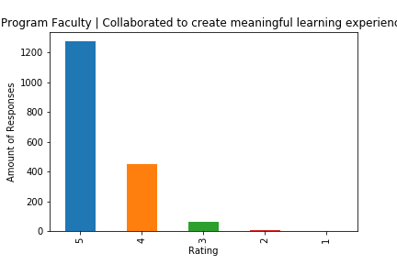
Faculty Findings
A Rating of 5 made up 70 to 80 percent of responses for a majority of questions
A Rating of 4 made up 18 to 25 percent of responses for a majority of questions
A Rating of 3 made up less than 5 percent of responses

Slide 11
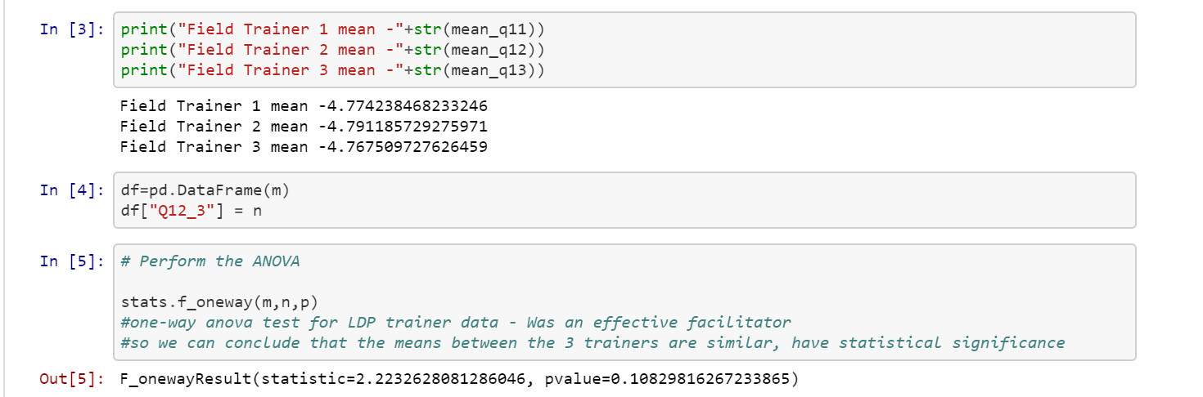
One-Way Anova Testing
pvalue=0.10829816267233865

Slide 12
Linear Regression Analysis
Objective: To determine which aspect of the Leadership trainings affect overall satisfaction the most according to survey data

Slide 13
Survey Data
Survey Questions:
Overall Satisfaction
If objectives were achieved
If students became more proactive in the organization
If tools and techniques were utilized
Etc…
If the objectives were applicable
If the knowledge and skills learned from the program can be applied
If the programs offered different perspectives
Faculty ratings
Food, Transportation, Hotel etc (for LOI only)
Question Rating: 1 to 5

Slide 14
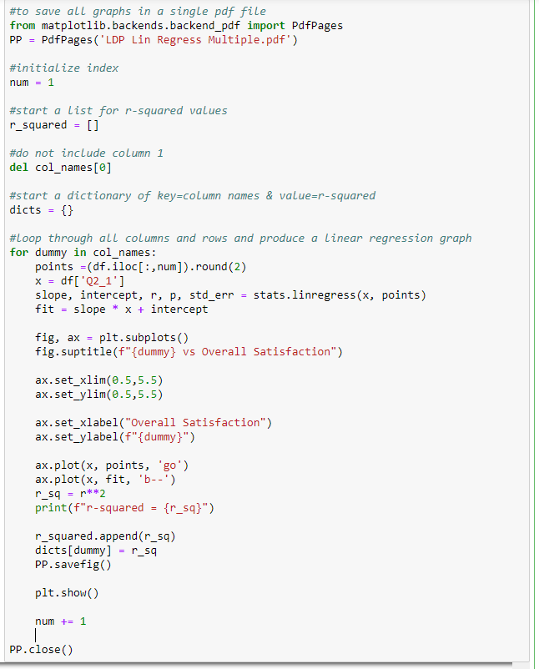
Code {Question} vs Overall Satisfaction
Only focused on columns where the data received were 1-5
Made sure all columns were the right data types- float
Removed rows with Nan
Created a loop that loops through all columns and rows and will produce a linear regression graph that compares other questions to overall Satisfaction
Saved all figures in one PDF file

Slide 15
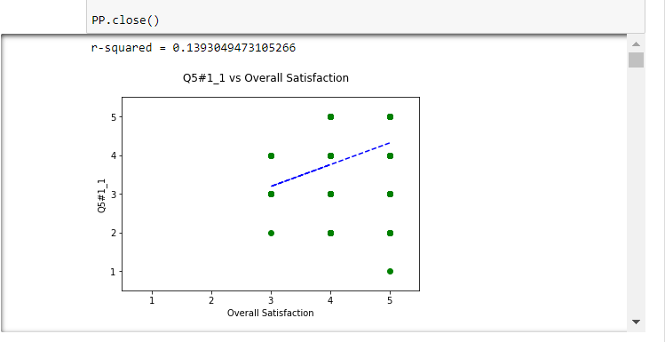
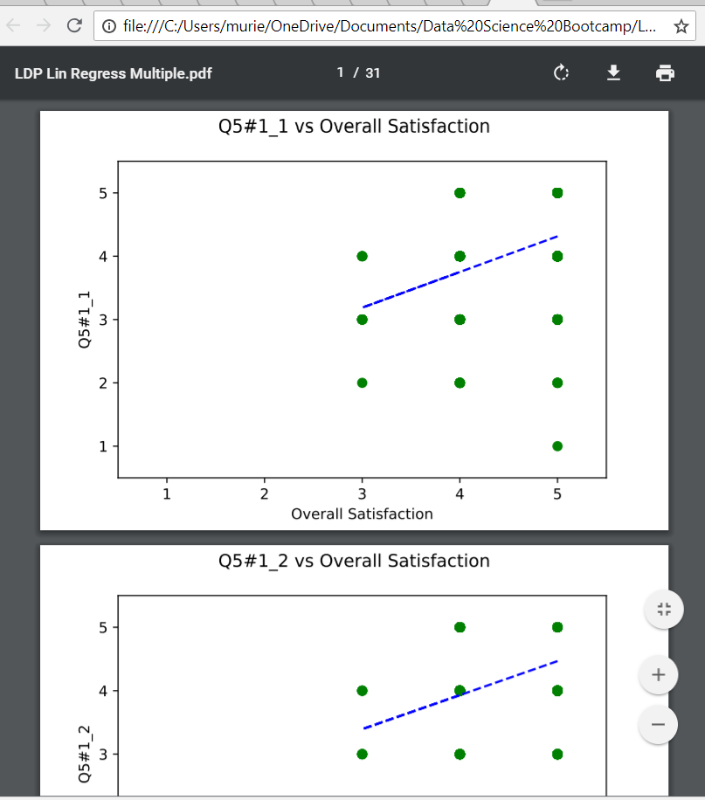
Results View samples
Jupyter Notebook
Browser

Slide 16
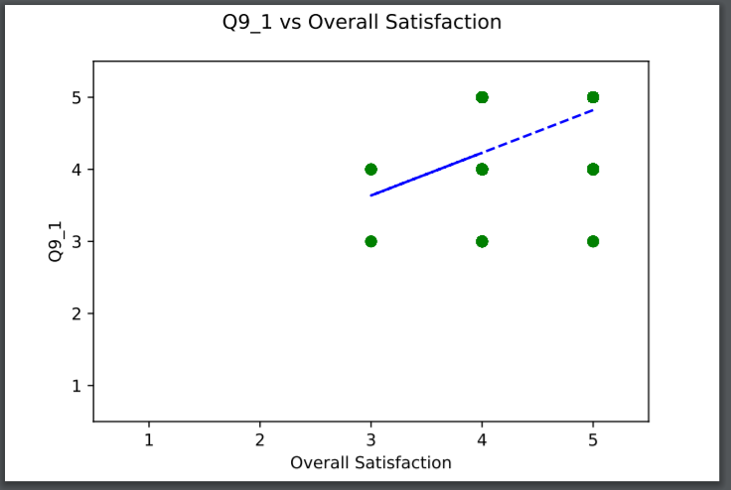
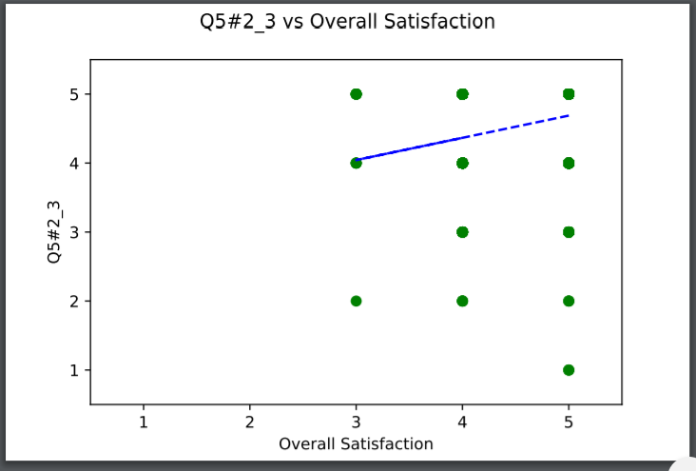
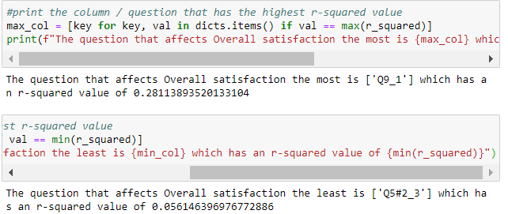
Findings
The aspect of the training that affected Overall Satisfaction the most is that “the field trainer was an effective facilitator of learning.”
R-squared = 0.28 ; Q9_1
The least important is that “the faculty collaborated in their approach to provide a meaningful learning experience for students.”
R-squared = 0.05 ; Q5#2_3
LDP

Slide 17
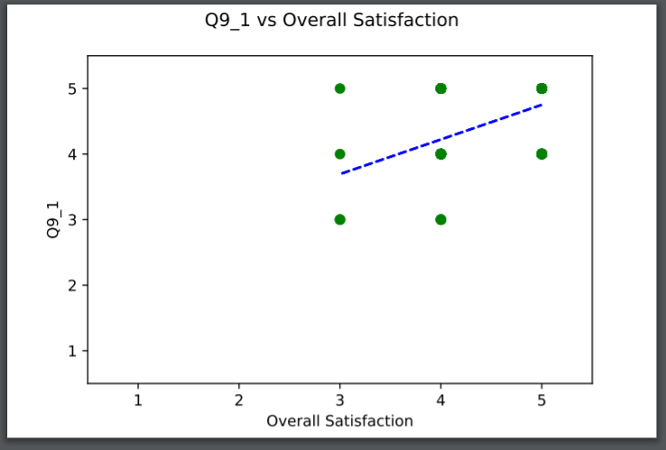
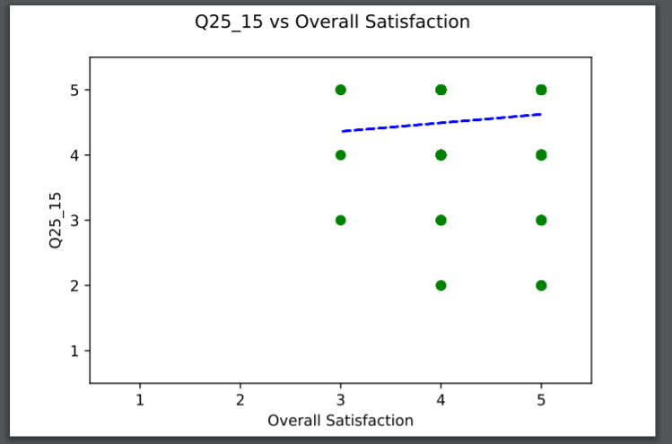
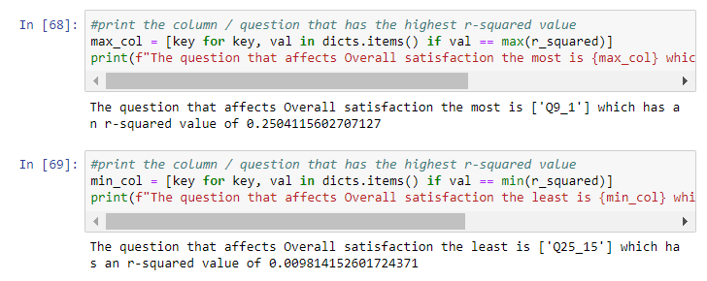
Findings
The aspect of the training that affected Overall Satisfaction the most is that “the faculty brought different perspectives in a complementary fashion that enhanced the learning experience.”
R-squared = 0.25 ; Q9_1
The least important is the hotel.
R-squared = 0.01 ; Q25_15
LOI

Slide 18
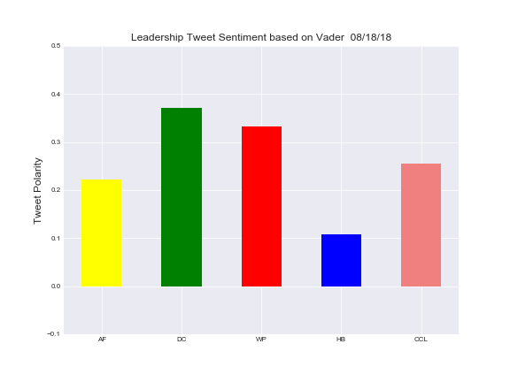
Twitter analysis of top competitors
Notes:
Five companies were selected to compare Tweets on Leadership to provide a Vader Analysis. I attempted to pull 1000 tweets from the organizations.
: Achieve Forum, Dale Carnegie, West Point, Harvard Business, and Center for Creative Leadership. West Point only had 576 tweets yet they ranked 2nd with positive sentiment. I revisited this and selected a new
All organizations are found to utilize < 140 characters, and include graphics in the form of a png or jpg file to communicate more information. It is important for CCL to be mindful of keeping the Tweet Text and the slide show consist.
I was able to pull 1000 tweets from the organizations. Niche similar to CCL , small to medium vs vs Corfairy.

Slide 19
Tweets by Company (as of: 8/18/2018)
 | Tweets | Following | Followers | Likes | Lists
AchieveForum | 6,710 | 2484 | 3580 | 101 | 1
Dale Carnegie | 20K | 13.1K | 117K | 12.6K | 3
WestPoint | 547 | 142 | 391 | 368 | 0
Harvard Biz Review | 68.2K | 198 | 5.37M | 20 | 2
CCL | 17.3K | 1,434 | 15.1K | 11.2K | 1
Findings:
Almost all Twitter tweets are using some form of graphic image, video, or .wav file.
CCL tweets are limited to .png and .jpg images but have quality messaging content.
HarvardBiz, WestPoint, and Dale Carnegie share statements not solely focused on Leadership.
AchieveForum is a new entry into the market also does not have a large number of followers
Following and Followers is a discussion point (following – what data do you get back and how is it analyzed?
HarvardBiz has 20 likes (Twitter error?) or NO ONE LIKES THEM!
Notes:
Dale Carnegie is leading the pack in POSITIVE tweet analysis and has reached a considerable audience when compared to HarvardBiz you can see the sentiment is misaligned. We have viewed the images and found two critical points for CCL to adopt. 1. Post tweet images with the CCL logo/name to ensure copyright or if it is tweeted again, future customers will want to follow you and adopt your positivity. 2. Employ a bot to push your message out and connect via LinkedIn.

Slide 20
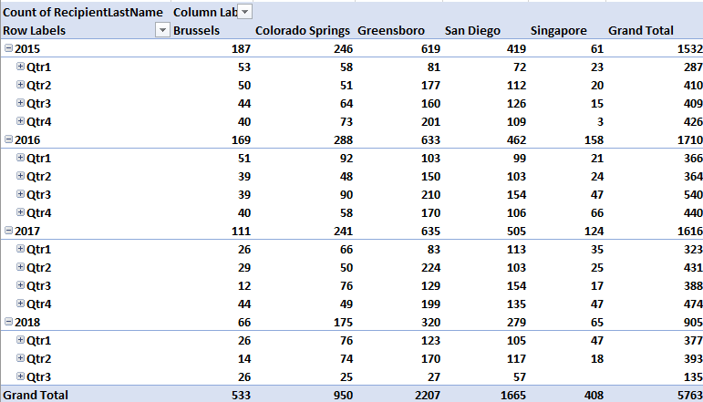
Leadership Courses require a CCL Mgmt Review
Notes:
The CCL Leadership Courses were analyzed from 2015-2018 for the WHO, WHAT, WHEN, WHERE… but we want to understand WHY the decline in enrollment and determine what is causing the growth and / or reduction.

Slide 21
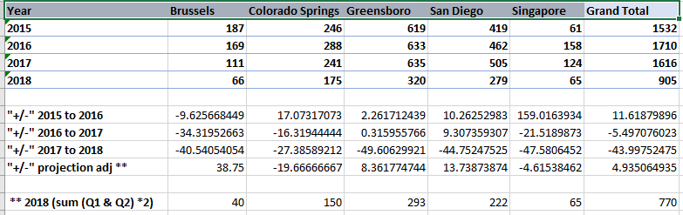
Leadership Analysis Mgmt Review
Findings:
Compare assessment count data to sales data to address the declines.
An attendance projection of the first half of the year addresses some of the 2017-2018 numbers.
CCL needs to determine if all attendees completed assessments.
The CCL Sales team needs to fill the classroom to take advantage of maximum capacity without impacting the program quality and student satisfaction.

Slide 22
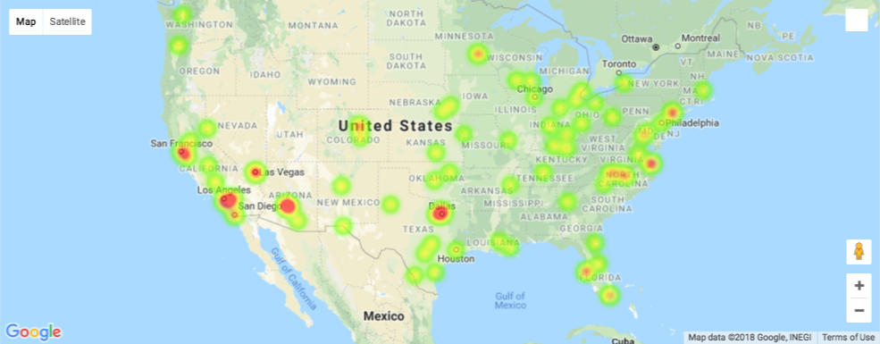
Leadership Heat Map (USA Locations)
Simulated Heat Map

Slide 23
Build a better future for your yourself!
Build Trust
Shape a motivational workplace
Clarify performance expectations (individual and team)
Give needs based feedback to others
Realize the talent in others
Offer rewards and recognition that build motivation
Correct performance problems

Slide 24

Recommendations
Twitter
All CCL graphics and video content should display the CCL name and have a copywrite.
Text in tweets should be consistent with graphic content improving the Vader sentiment analysis.
Track CCL and competitor tweets (quarterly for mgmt dashboards)
Promote CCL services by varying the message - track to sales data.
Cite all non-CCL content
Engage Clients to tweet to their employees and promote their business and CCL.
Current and Future Clients
Engage current CCL Clients during class and obtain five names of individuals that would benefit from CCL services.
Promote profitable CCL services or courses in all classes.
Source new Clients based on Bloomberg business/industry for growing and declining businesses.
Engage the CCL Sales Team to fill the empty seats for each session.
Regionally grow CCL awareness through Social Media services.
Employ Bots to distribute tweets.
http://ww.staceymyers.com/what-can-i-tweet/

Slide 25
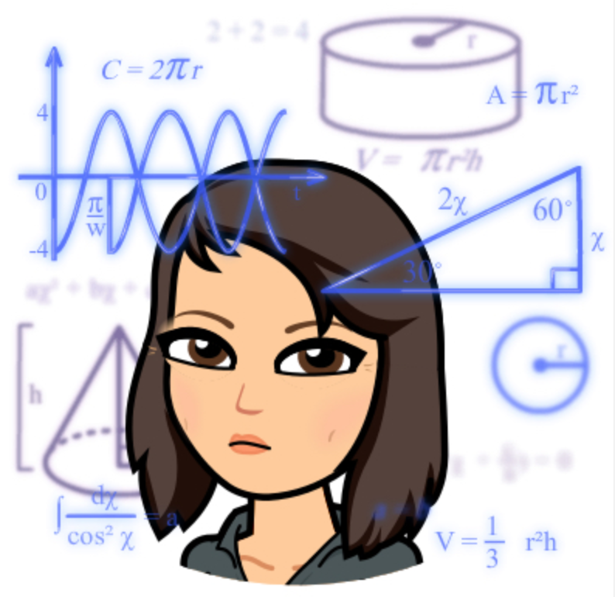
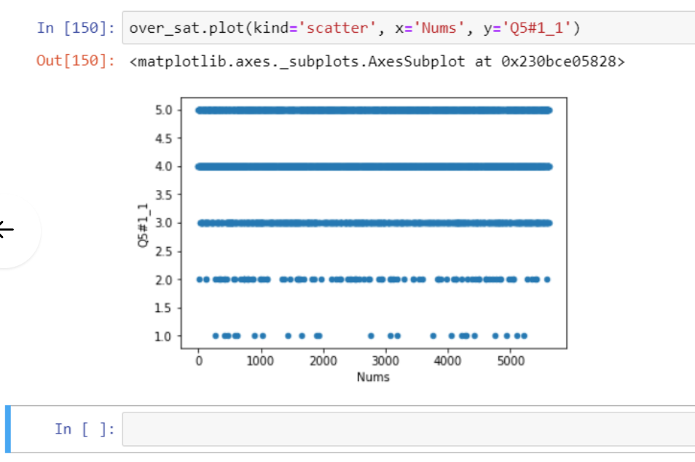
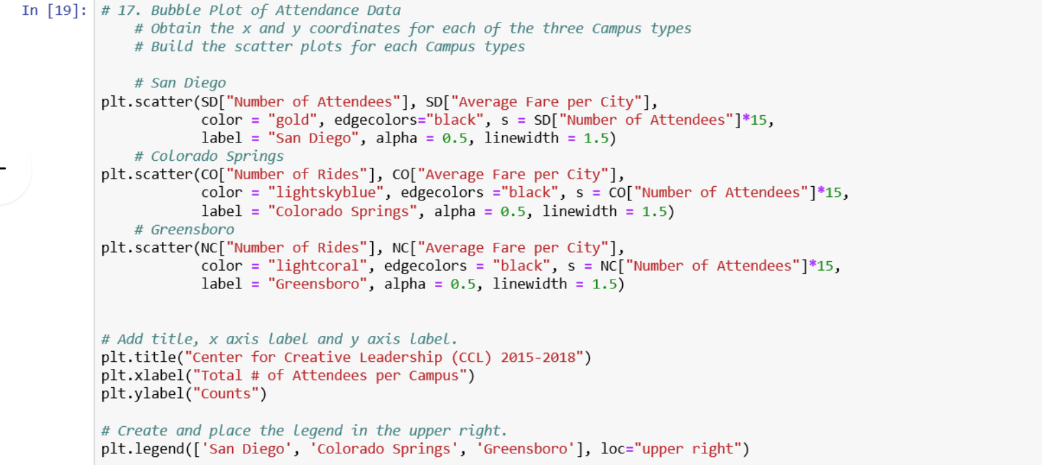
Coding Bloopers

